Slide 1
Data Battles
R Group
Andrew Lapointe
Notes:
https://github.com/ismayc/talks/blob/master/ness-infer/slide_deck.pdf
Explains some basic concepts → pipe operator etc.
https://slideplayer.com/slide/10901128/

Slide 2

Keys to Success
Keys to Success
Keep an open-mind
If it looks weird and confusing → ASK
Patience!

Slide 3
Copy/Paste Learning
Copy/Paste Learning
Focus on the parts of code that need to be changed.
Allows for objective (rather than theory) based learning
Google your problems away!!!

Slide 4
To Do (not in presentation)
Keys to Success
Installing R + RStudio
Discuss Project Folder Organization
Why is this important??
Navigating RStudio
Here I can show them how to switch to dark theme
Types of R files and what they do
Notes:
Give them a scenario where your PI asks you to remove the data from one participant and re-run your analysis

Slide 5
Installing R
Installing R + RStudio

Slide 6
Installing R
Andrew’s CIHR Updates
Please go to my GitHub page and Install the files listed.
There is also a USB key circulating for those with slower connections

Slide 7
https://www.youtube.com/watch?v=ut0LAjpon6I

Slide 8
Familiarize Yourself With The Environment
Andrew’s Updates

Slide 9
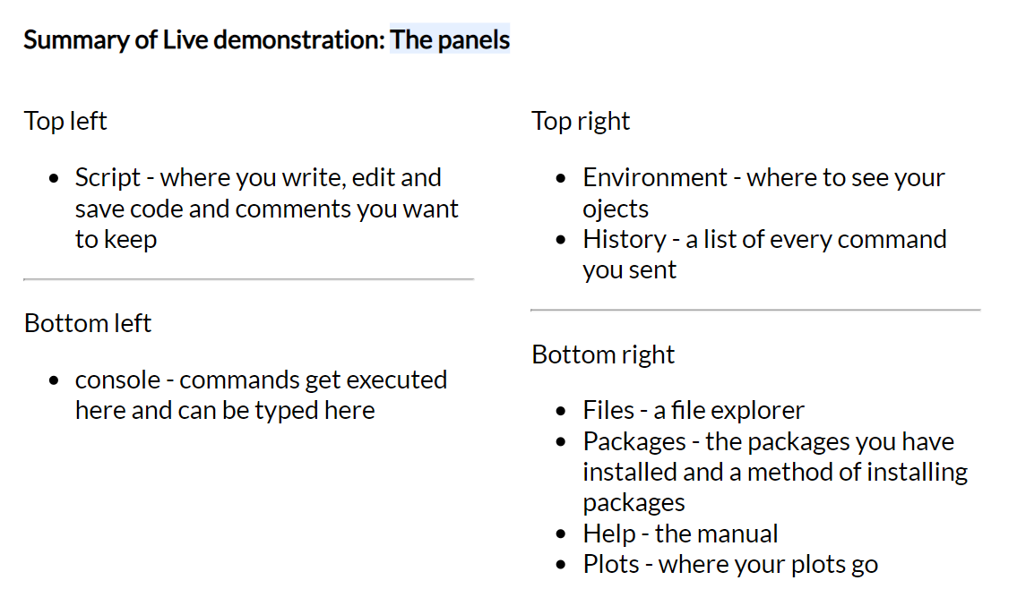
Environment
Andrew’s Updates
This can be intimidating at first glance but let’s break it down

Slide 10
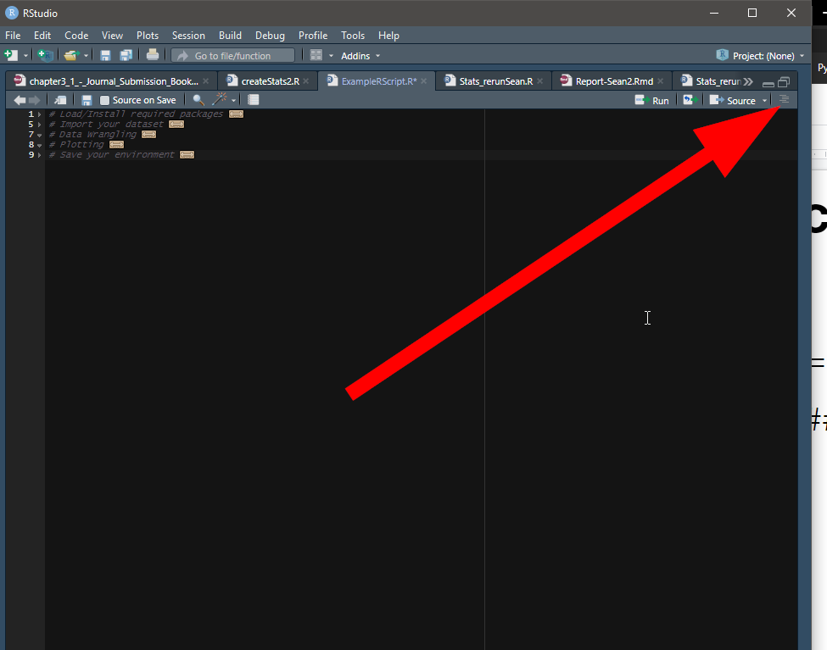
Document Outline
Andrew’s Updates
Ctrl + Shift +O

Slide 11
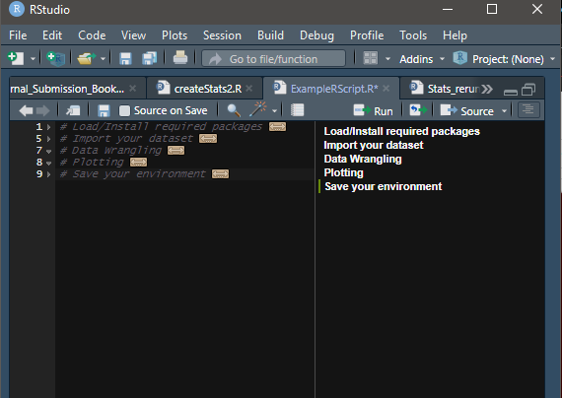
Document Outline
Ctrl + Shift +O

Slide 12
Creating Sections
Andrew’s Updates
#Section 1 -----------
#Section 1a ===========
#Section 1ai #########

Slide 13
Starting our Project
Andrew’s Updates

Slide 14
Types of Files
Andrew’s Updates
Folder structure is shown but there are two important files
*.RProj
Sets the directory so you can work on multiple computers. This is the file you should click on from Windows Explorer
*.R
Script
Contains the actual code

Slide 15
What Are We Covering Today?
Dami’s Updates
Loading/Installing Packages
Importing a Dataset
Data Wrangling
Plotting
Introductory Statistics
Saving our environment
This will come into use later.

Slide 16
Structure of a script
Dami’s Updates
Loading/Installing Packages First
Importing Data second
Data Wrangling / Plotting / Statistics
Saving our environment
Always at the end
Notes:
The structure of your script will almost always follows a very similar format. 1,2 and 4 will never change. Or at least they have not in any of my scripts

Slide 17
Loading/Installing Packages
In order to use functions, “packages” must be installed and loaded.
Packages only need to be installed once on a given computer
Afterwards they will only need to be loaded
Therefore expect the first time to be slow
In order to accomplish both install and loading we use pacman
if (!require("pacman")) install.packages("pacman")
pacman::p_load(PackageName1, PackageName2)
Installing Packages
# Load/Install required packages ---------------------
if (!require("pacman")) install.packages("pacman")
pacman::p_load(readxl, ggplot2, esquisse, Rmisc)
Notes:
This can be one of the trickier parts of R for beginners so I have simplified the code as much as possible. You don’t need to concern yourself with the nuances of this code too much. Just note the text in red.

Slide 18
General Information
We use # to indicate a comment
This will not run
# total number of nests
In R we use <- for assignment.
# total number of nests total_nests <- sum(freq)
Copy/Paste Learning
Effective for objective based learning
functionName(argument1= xx , argument2=xx…)
General Information

Slide 19
Functions in R (e.g read_excel)
read_excel() reads xlsx and xls (Excel) extensions
Function Syntax

Slide 20
read_excel( )
read_excel(path, sheet = NULL, range = NULL, col_names = TRUE, col_types = NULL, na = "", trim_ws = TRUE, skip = 0, n_max = Inf, guess_max = min(1000, n_max), progress = readxl_progress(), .name_repair = "unique")
Function Syntax
ARGUMENT | DESCRIPTION
path | path to the file
sheet | name of the sheet you want to read
range | A cell range to read from, as described in cell-specification. Includes typical Excel ranges like "B3:D87", possibly including the sheet name like "Budget!B2:G14", and more. Interpreted strictly, even if the range forces the inclusion of leading or trailing empty rows or columns. Takes precedence over skip, n_max and sheet.
col_names | TRUE to use the first row as column names, FALSE to get default names, or a character vector giving a name for each column. If user provides col_typesas a vector, col_names can have one entry per column, i.e. have the same length as col_types, or one entry per unskipped column.
na | Character vector of strings to interpret as missing values. By default, readxl treats blank cells as missing data.
skip | Minimum number of rows to skip before reading anything, be it column names or data. Leading empty rows are automatically skipped, so this is a lower bound. Ignored if range is given.

Slide 21
I knew this was too good to be true

Slide 22
I knew this was too good to be true

Slide 23
The strength of functions
Simply because an argument exist does not mean it needs to be filled
This allows your code to be simple most of the time BUT
It also allows you to be very specific in instances where its required

Slide 24
Removing unused arguments to simplify
Importing a Dataset
read_excel(path, sheet = NULL, range = NULL, col_names = TRUE, col_types = NULL, na = "", trim_ws = TRUE, skip = 0, n_max = Inf, guess_max = min(1000, n_max), progress = readxl_progress(), .name_repair = "unique")
# Import your dataset ---------------
df <- readxl("datasets.xlsx", Sheet = “SheetName”)

Slide 25
Importing a Dataset
We can import using a dropdown menu
Or we can use very simple code.
Here we have called our dataset “df” which stands for “dataframe”. You can name it whatever you want but df is nice because its short and it is a good idea to keep names consistent across projects to save you time.
Importing a Dataset
# Import your dataset ---------------
df <- readxl("datasets.xlsx", Sheet = “SheetName”)

Slide 26
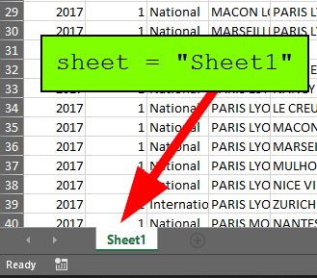
Importing a Dataset
Importing a Dataset
# Import your dataset ---------------
df <- readxl("datasets.xlsx", sheet = “Sheet1”)

Slide 27
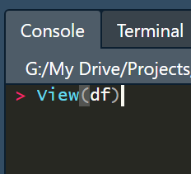
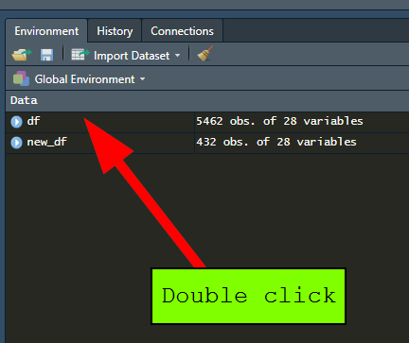
Visualize df
Console
Point/Click
Then press “Enter”

Slide 28
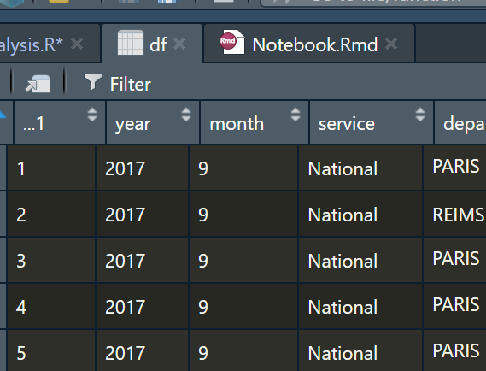

Visualize your Dataset
Notice that we can perform some filtering on the dataset within this View in order to give us some preliminary insight on our data.
Importing a Dataset

Slide 29
Cleaning up df
Renaming Columns
Filtering by a condition
Creating a subset
Transformations

Slide 30
Renaming a column
Renaming a column
# Renaming a column ===========
df <- df %>% rename( #‘New Column Name’= ‘Old Name’ month"= "Month" )

Slide 31
Renaming a column
Renaming a column
# Filtering our data that fits a condition ========= new_df <- filter(df, service=="International") # give me a new dataframe with only the international services.

Slide 32
Summarizing Content
There are so many programs/functions to do this. We will be using Rmisc
Summarizing Content

Slide 33
summarySE
summarySE is a function that gives:
count
mean
standard deviation
standard error of the mean,
confidence interval (default 95%).
Function Syntax

Slide 34
summarySE
summarySE(data = NULL, measurevar = NULL, groupvars = NULL, na.rm = FALSE, conf.interval = 0.95, .drop = TRUE)
Function Syntax
ARGUMENT | DESCRIPTION
data | A data frame
measurevar | the name of a column that contains the variable to be summarized (numeric)
groupvars | a vector containing names of columns that contain grouping variables
na.rm | a Boolean that indicates to ignore NA’s
conf.interval | the percent range of the confidence interval (default is 95%)
.drop | should combinations of variables that do not appear in the input data be preserved (FALSE) or dropped (TRUE, default)

Slide 35
What do we want to plot???
Summarizing and plotting go hand in hand.
Let’s pick some variables to summarize
journey_time_avg
service
year

Slide 36
summarySE
ARGUMENT | DESCRIPTION | Usage?
data | A data frame
measurevar | the name of a column that contains the variable to be summarized (numeric)
groupvars | a vector containing names of columns that contain grouping variables
na.rm | a Boolean that indicates to ignore NA’s
summarySE(data = NULL, measurevar, groupvars = NULL, na.rm = FALSE, conf.interval = 0.95, .drop = TRUE)
Function Syntax
Notes:
Hide this then show it

Slide 37
summarySE
ARGUMENT | DESCRIPTION | Usage?
data | A data frame | df
measurevar | the name of a column that contains the variable to be summarized (numeric) | journey_time_avg
groupvars | a vector containing names of columns that contain grouping variables | service, year
na.rm | a Boolean that indicates to ignore NA’s | TRUE
summarySE(data = NULL, measurevar, groupvars = NULL, na.rm = FALSE, conf.interval = 0.95, .drop = TRUE)
Function Syntax
journey_time <- Rmisc::summarySE(
data = df,
measurevar = "journey_time_avg",
groupvars = c("service","year"),
na.rm = TRUE)
Notes:
Hide this then show it

Slide 38
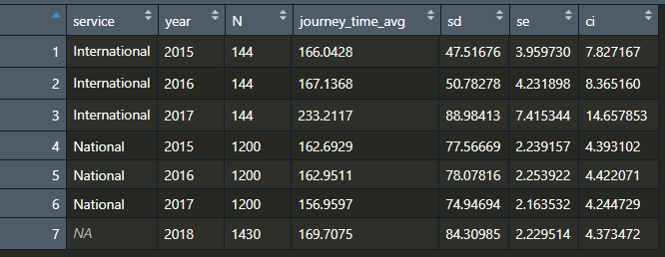

Slide 39
Plotting using ggplot
Works as layers.
We will cheat and use esquisse
Plotting
Notes:
aes stands for “aesthetics”

Slide 40
Main Setup
myPlotName <- ggplot(
data = dfName, aes(x = x_variable, y = y_variable, fill = group_variable)
Notes:
aes stands for “aesthetics”
What do we need to make a plot???
we need a data source

Slide 41
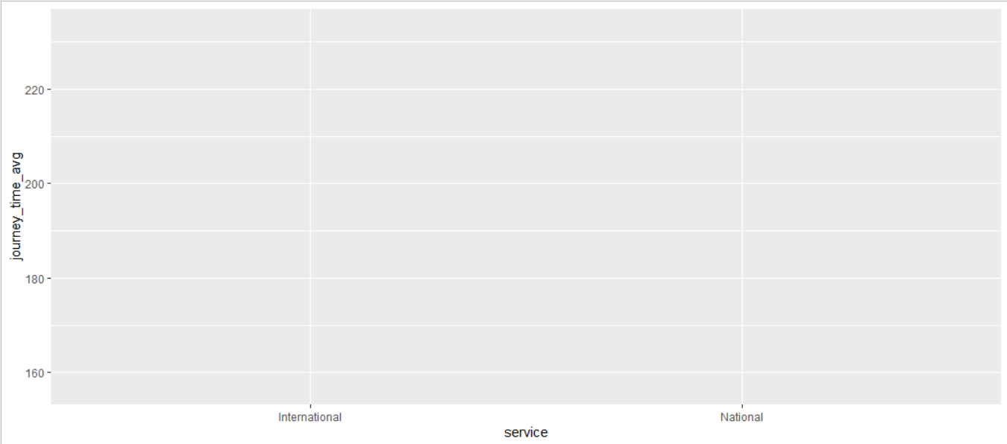
Y variable
X variable

Slide 42
Types of plots?
More to chose from that I can outline here
geom_jitter
geom_bar
geom_histogram
geom_area

Slide 43
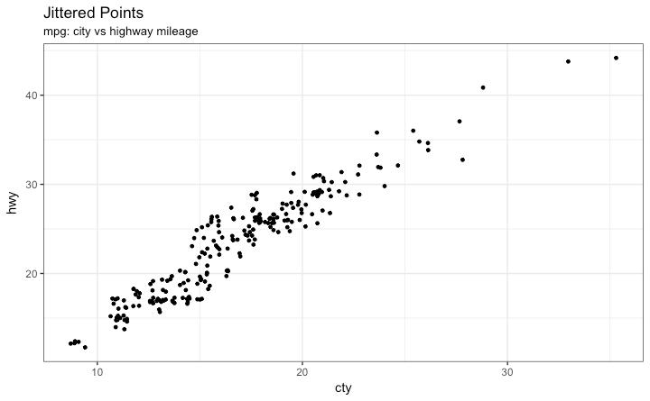
geom_jitter

Slide 44
geom_bar

Slide 45
geom_histogram

Slide 46
geom_boxplot

Slide 47
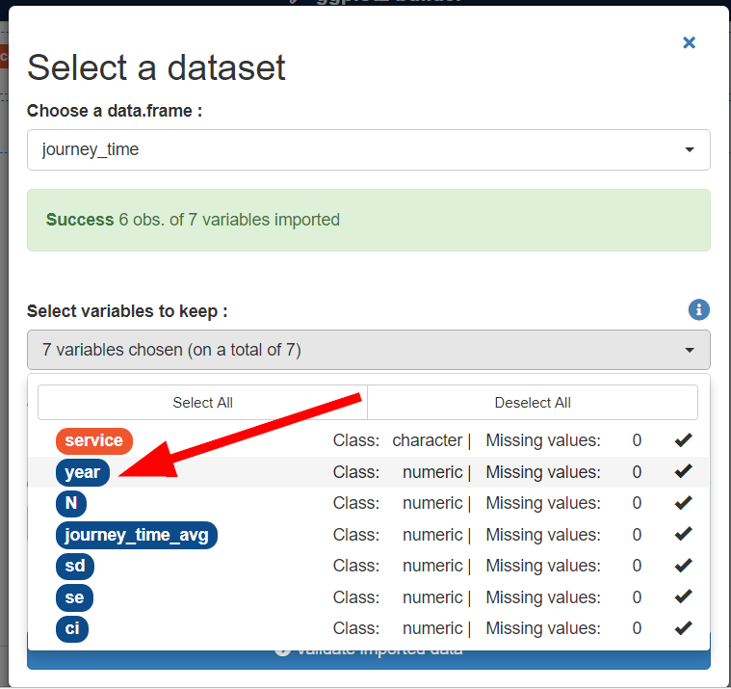

Slide 48
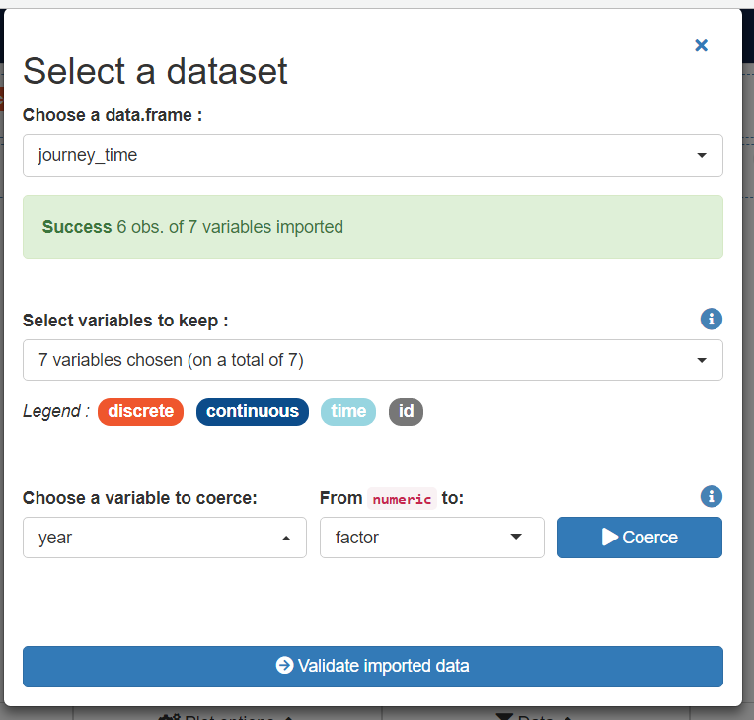

Slide 49
Main Setup
myPlotName <- ggplot(
data = dfName, aes(x = x_variable, y = y_variable, fill = group_variable)
Type of Plot
geom_boxplot()
Notes:
aes stands for “aesthetics”
What do we need to make a plot???
we need a data source

Slide 50
Saving our plot
# Save the plot we created ====================
ggsave("images/plot1.png",plot1, width=11, height=8.5, dpi=300)

Slide 51
ANOVA
# testing to see if the type of service has an effect on the Journey Time
model <- lm(journey_time_avg ~ service, data=df)
modsum <- summary(model) modsum

Slide 52
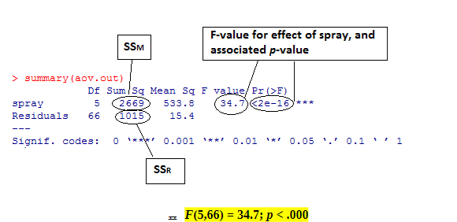
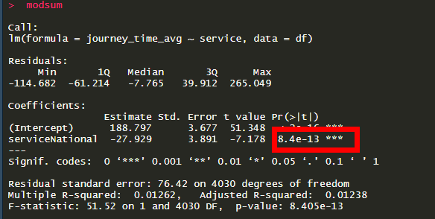
Running an ANOVA

Slide 53
Running an ANOVA

Slide 54
Saving our Data
Saving our data
In order for us to be able to access our models later we are going to save them as an .Rdata file.
We will save
Statistical Models
Tables (or df)
This is simply good practice
We won’t go over how to write a document in RMarkdown but just know that it is possible and exceptionally powerful
# Save it to .RData -----------
save(journey_time,modsum, file = "data/analyzedData.RData")

Slide 55
Future Directives
We have now created a reproducible script!!
But we can also make an entirely reproducible document/manuscript
Imagine being able to make changes to a dataset and instantly your entire manuscript makes changes!!!!
Here I am going to show you an example of how this can be done.
Saving our data
Notes:
Andrew Notes: Show them how to incorporate what they have down into RMarkdown. Demonstrate the difference in time saved between Excel → SPSS → Word and RMarkdown.

Slide 56
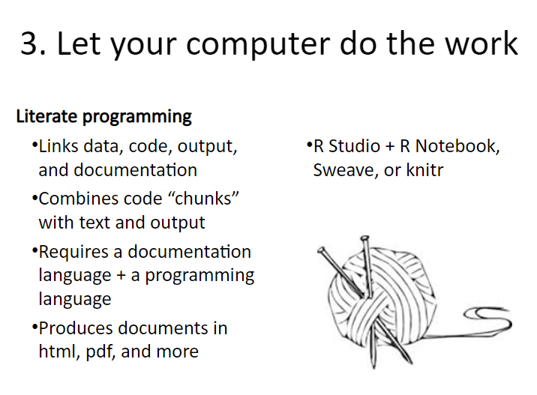
Literate Programming
Saving our data
Notes:
Andrew Notes: Show them how to incorporate what they have down into RMarkdown. Demonstrate the difference in time saved between Excel → SPSS → Word and RMarkdown.

Slide 57
Requirement
Not fully covered in this workshop but it should allow you to see the potential

